Slide 1
Virtual Network In Azure
Sarang Joshi

Slide 2
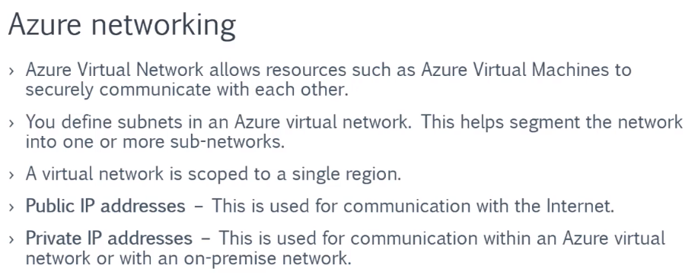
Key Point

Slide 3
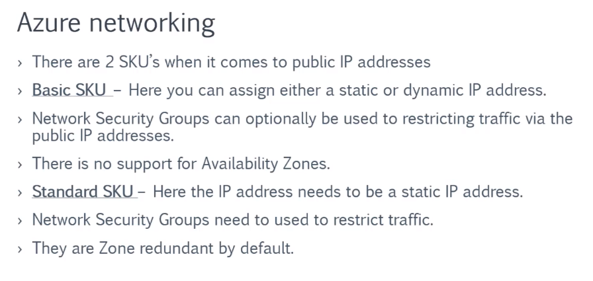
Key Point

Slide 4
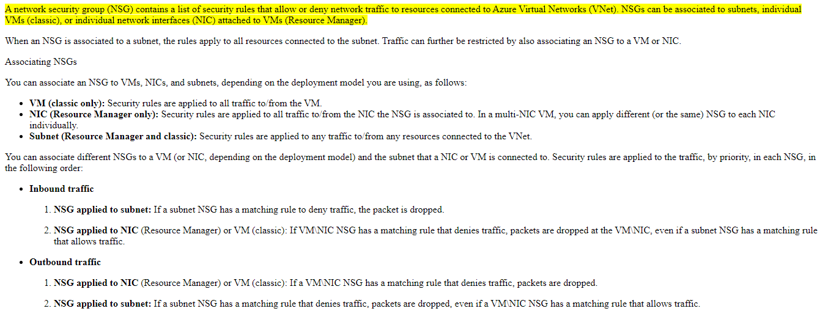
NSG

Slide 5
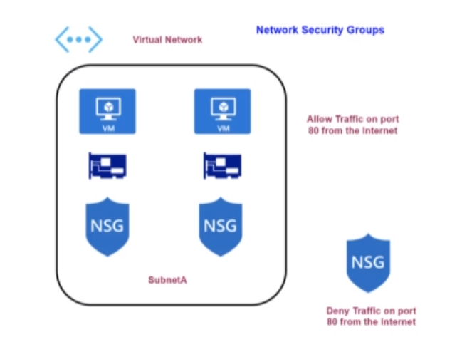
Network Security Group-Subnets

Slide 6
DEMO
NSG rule
Standard and basic sku
Rule None
Priority
NSG Subnet

Slide 7


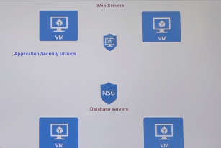

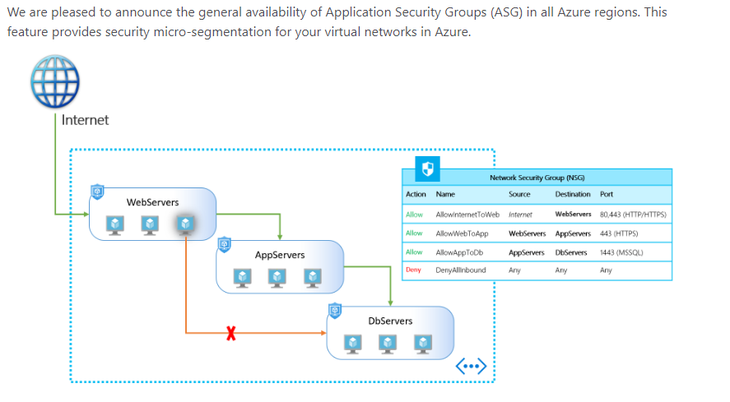
Application Security Group
z

Slide 8
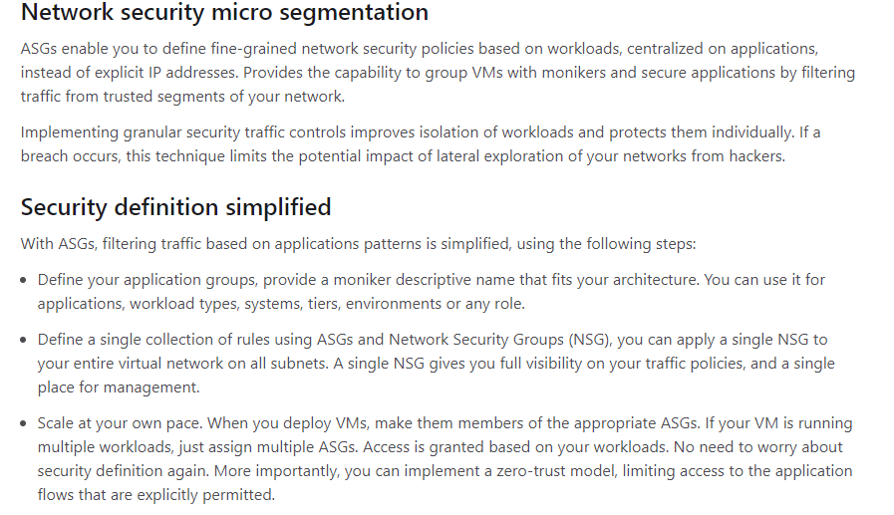
Application Security Group
z

Slide 9
DEMO
ASG

Slide 10
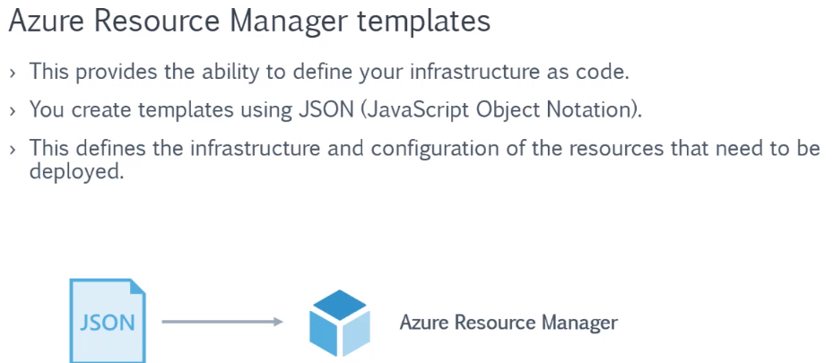
ARM

Slide 11
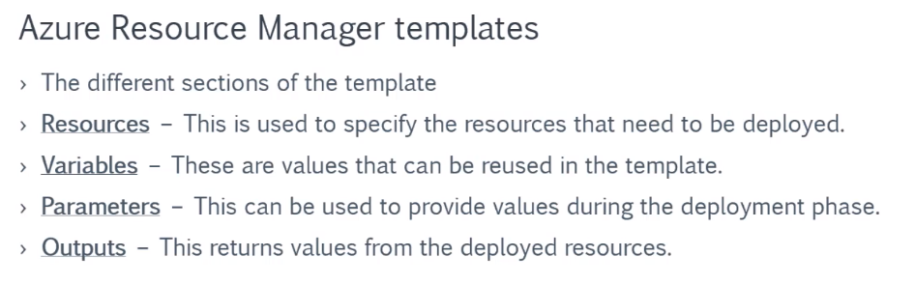
ARM

Slide 12
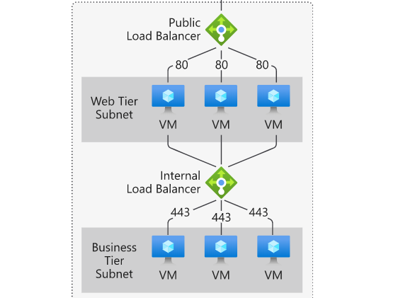
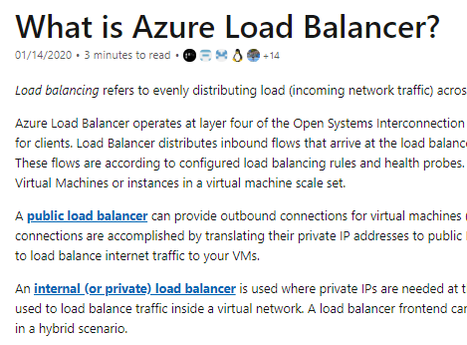
Load Balancer
z

Slide 13
Basic VS standard load balancer
The Basic tier is quite restrictive. A load balancer is restricted to a single availability set, virtual machine scale set, or a single machine. The Standard tier can span any virtual machine in a single virtual network, including blends of scale sets, availability sets, and machines

Slide 14
DEMO
Load Balancer basic
Load Balancer standard
Load Balancer without Ip

Slide 15
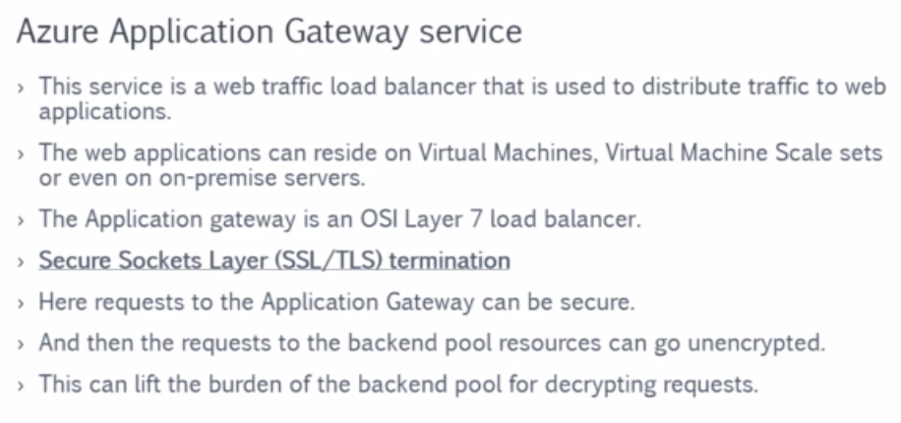
Azure Application Gateway Service

Slide 16
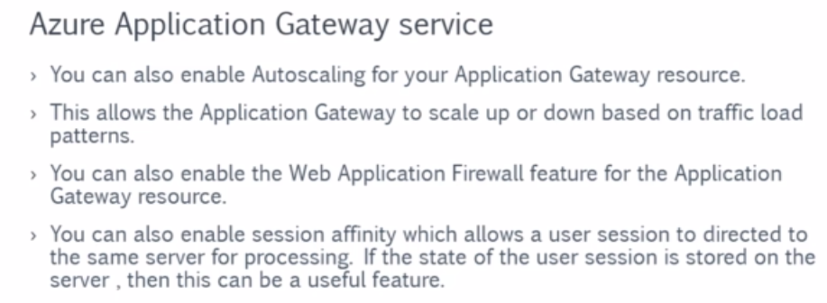
Azure Application Gateway Service

Slide 17
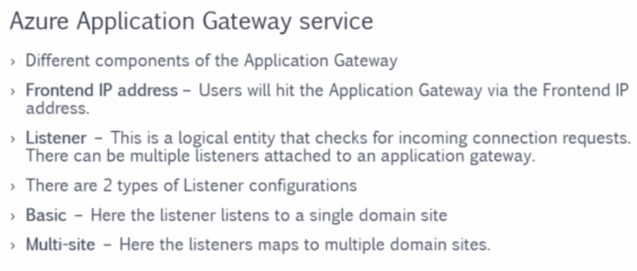
Azure Application Gateway Service

Slide 18
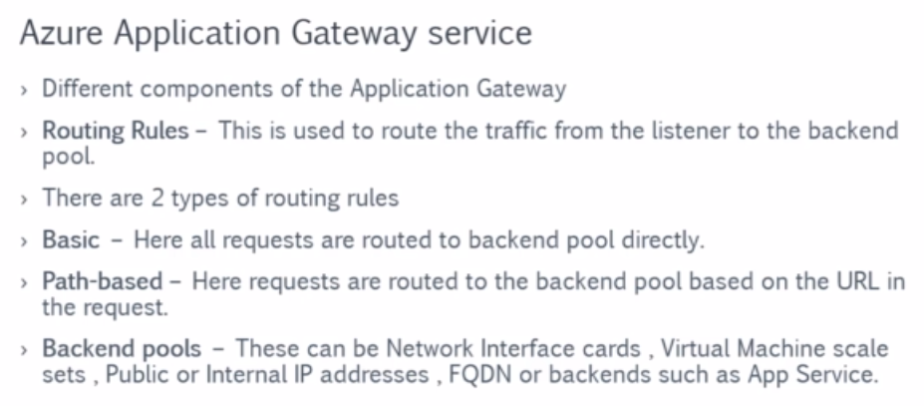
Azure Application Gateway Service

Slide 19
DEMO
Azure Application Gateway

Slide 20
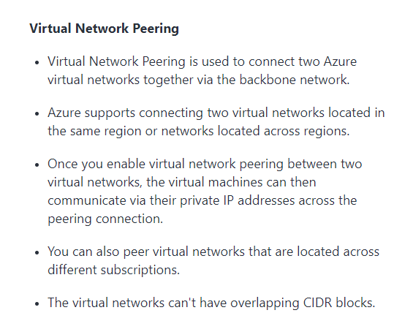
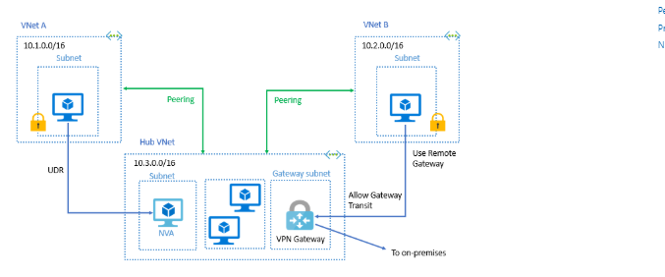
Virtual Network peering
z

Slide 21
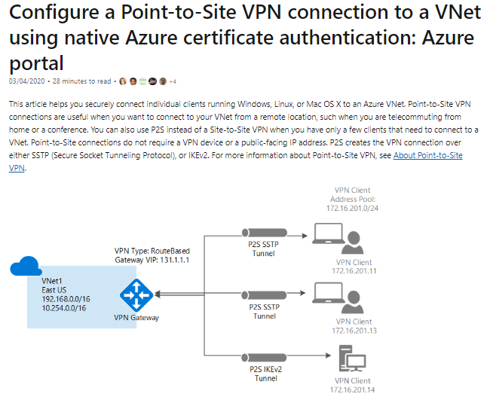
Point-to-Site VPN connection

Slide 22
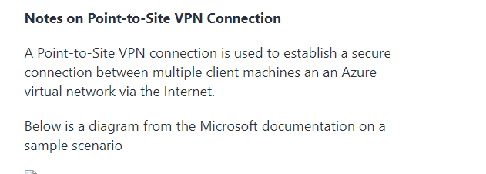
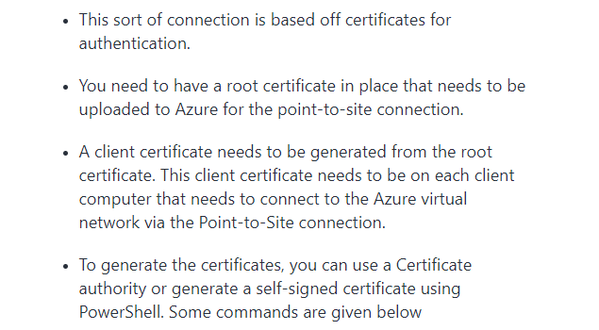
Point-to-Site VPN connection

Slide 23
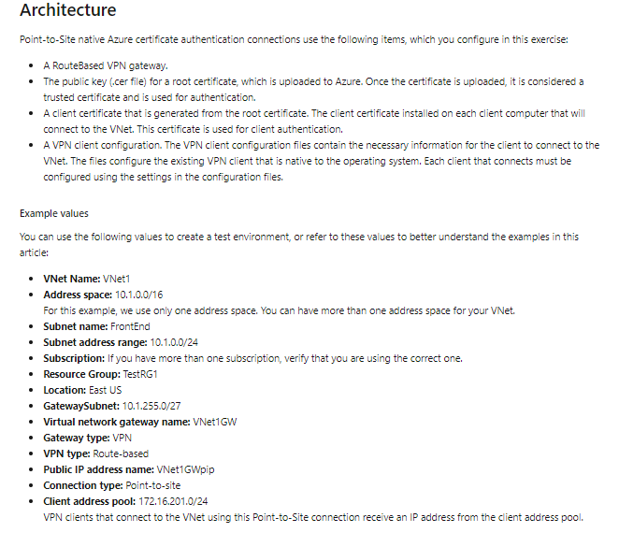
Point-to-Site VPN connection

Slide 24
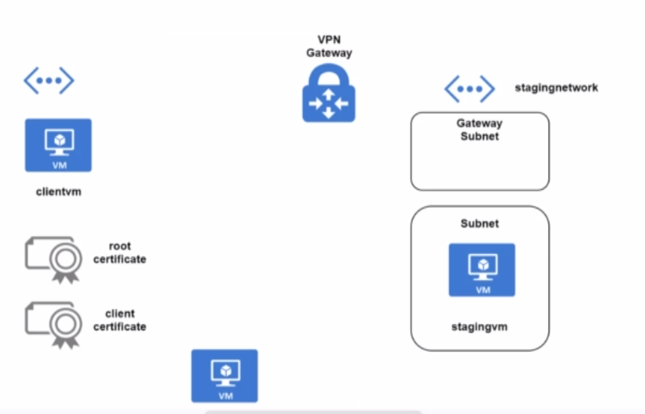
VPN DEMO
z

Slide 25
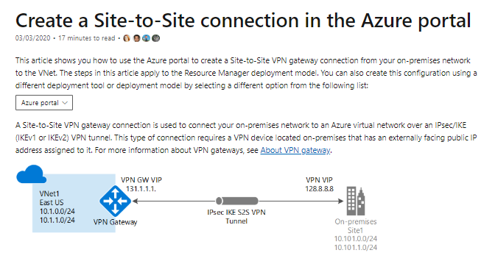
Site to Site VPN connection

Slide 26
Site to Site VPN connection
Notes on Site-to-Site VPN Connection
A Site-to-Site VPN connection is used to establish a secure connection between an on-premise network and an Azure network via the Internet.
On the on-premise side, you need to have a VPN device that can route traffic via the Internet onto the VPN gateway in Azure. The VPN device can be a hardware device like a Cisco router or a software device ( e.g Windows Server 2016 running Routing and Remote services). The VPN device needs to have a publically routable IP address.
The subnets in your on-premise network must not overlap with the subnets in your Azure virtual network
The Site-to-Site VPN connection uses an IPSec tunnel to encrypt the traffic.
The VPN gateway resource you create in Azure is used to route encrypted traffic between your on-premise data center and your Azure virtual network.
There are different SKU's for the Azure VPN gateway service. Each SKU has a different pricing and attributes associated with it - Reference - https://docs.microsoft.com/en-us/azure/vpn-gateway/vpn-gateway-about-vpn-gateway-settings

Slide 27
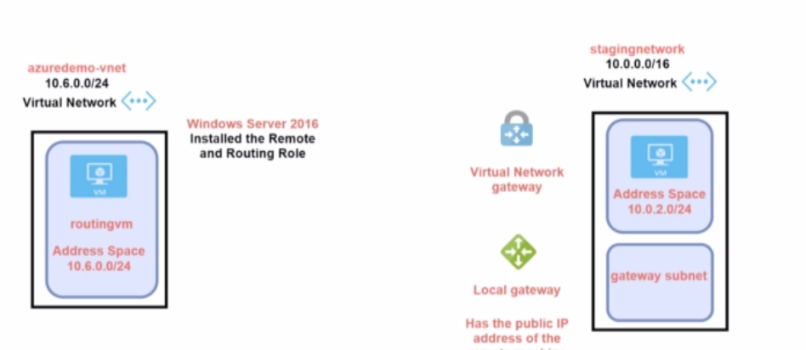
Demo Site to Site VPN

Slide 28
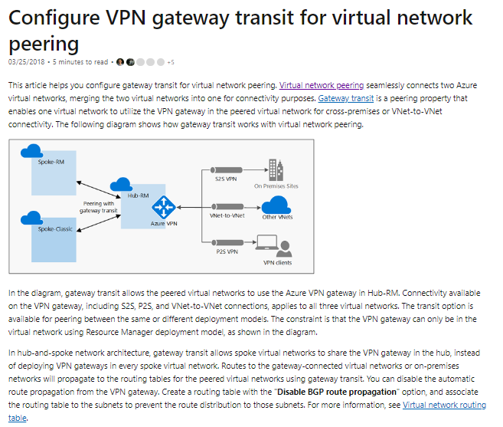
Gateway Transit

Slide 29
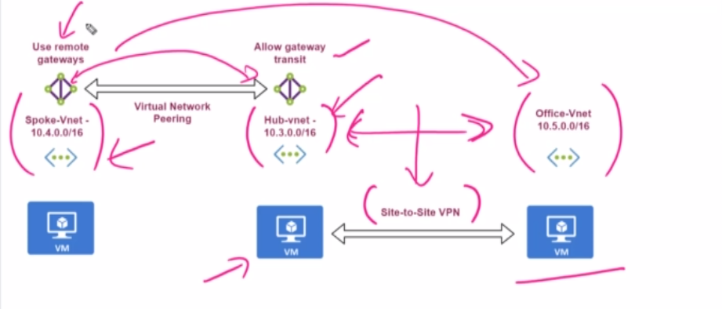
DEMO

Slide 30
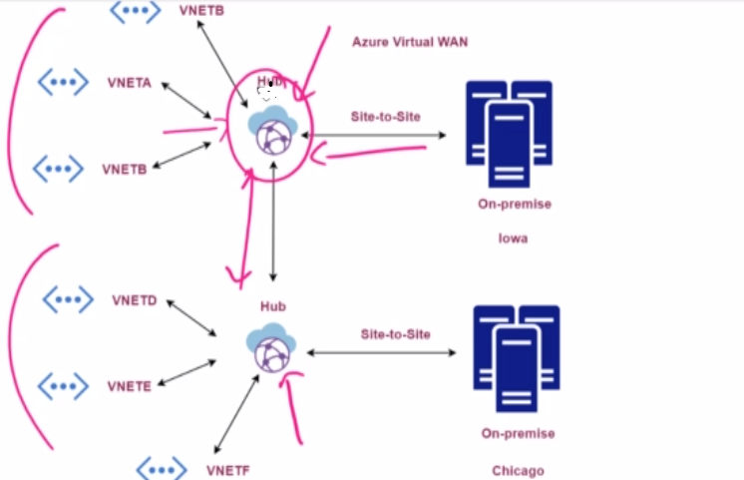
AZURE VIRTUAL WAN
z

Slide 31
Network Watcher
Azure Network Watcher provides tools to monitor, diagnose, view metrics, and enable or disable logs for resources in an Azure virtual network. Network Watcher is designed to monitor and repair the network health of IaaS (Infrastructure-as-a-Service) products which includes Virtual Machines, Virtual Networks, Application Gateways, Load balancers, etc. Note: It is not intended for and will not work for PaaS monitoring or Web analytics.

